Slide 1

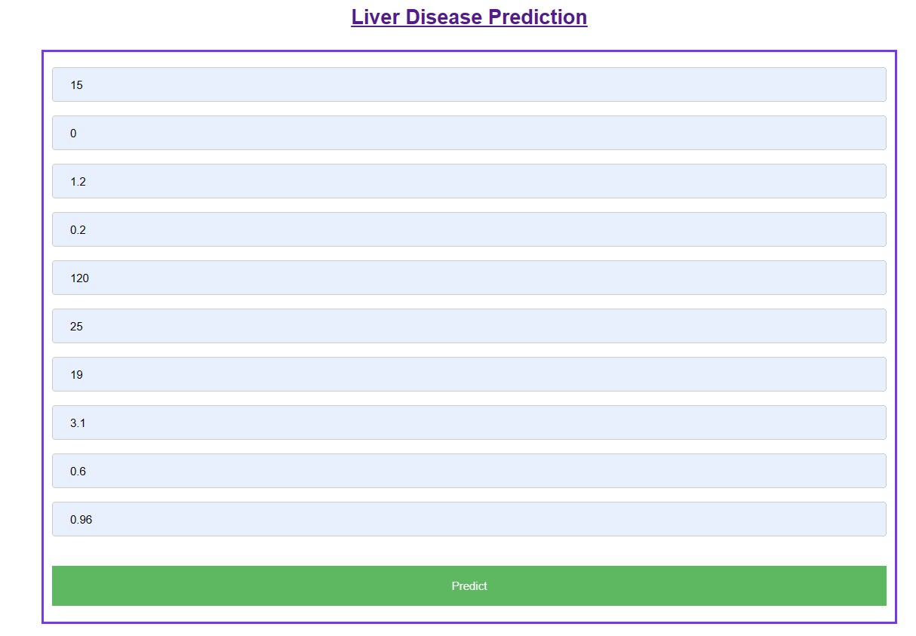
IMAGE RECOGNITION OF SPECIES USING CNN
BATCH NO : 56
ABSTRACT
CONCLUSION & FUTURE SCOPE
Liver diseases are significant health concern globally, attributed to various factors including alcohol consumption, exposure to environmental toxins, and poor dietary habits. Early detection of liver disease is crucial as it allows for timely intervention and management, which can significantly improve patient outcomes and reduce the burden on healthcare systems. The main aim of our project is to detect the liver disease accurately using parameters like age ,gender, total Bilirubin, Alkaline phosphatase, Aspartate aminotransferase, Albumin, Globulin ranges. The Existing model used to predict the liver cancer by using the random forest algorithm. The drawback of existing system is that the accuracy of model is less. The proposed model used to detect liver disease using K-Nearest Neighbor (K-NN) technique. The steps we follow to implement our model include collecting and preprocessing relevant datasets, identifying informative features, and training machine learning algorithms, the system can accurately detect the likelihood of liver cancer development or progression.
In conclusion, the liver disease analysing and prediction project utilizing the K-Nearest Neighbor (KNN) algorithm offers a promising approach in improving the prediction of outcomes for patients at risk of liver disease. By analyzing patient data and identifying key patterns, KNN enables early detection of chances of having liver disease. Its simplicity, efficiency, and effectiveness make it a valuable tool for healthcare professionals in early detection, diagnosis, and proactive management of liver diseases. In future we would try to enhance the algorithm's performance, particularly in handling large-scale datasets and improving its predictive accuracy. The K-NN model can be continuously improved by incorporating new data and features, enabling more accurate and reliable liver disease prediction. The K-NN technique can be applied to other diseases, enabling the development of accurate and reliable predictive models for various medical conditions.
OBJECTIVES
REFERENCES
Early Detection: To develop a predictive model capable of identifying individuals at risk of developing liver disease at an early stage, enabling timely interventions and preventive measures to mitigate disease progression and complications.
Accuracy and Reliability: To Improve the accuracy and reliability of liver disease prediction model to ensure effective clinical decision-making and patient management.
Patient Empowerment: Empower patients with information about their liver health status, risk factors, and personalized recommendations for lifestyle modifications, preventive screenings, and follow-up care to promote active engagement in disease management and improve long-term health outcomes.
Gupta, A., Biwal, R., Joshi, S., & Singh, P. A COMPARATIVE STUDY ON LIVER DISEASE PREDICTION USING SUPPORT VECTOR MACHINE ALGORITHM.
W. Yu, T. Liu, R. Valdez, M. Gwinn, and M. J. Khoury, ‘‘Application of support vector Machine modeling for prediction of common diseases: The case of diabetes and pre-diabetes,’’ BMC Med. Inform. Decis. Making, vol. 10, no. 1, p. 16, 2010.
Q. Zou, K. Qu, Y. Luo, D. Yin, Y. Ju, and H. Tang, ‘‘Predicting diabetes mellitus with machine learning techniques,’’ Frontiers Genet., vol. 9, p. 515, Nov. 2018.
Z.-H. Zhou, Y. Jiang, Y.-B. Yang, and S.-F. Chen, ‘‘Lung cancer cell identification based on artificial neural network ensembles,’’ Artif. Intell. Med., vol. 24, no. 1, pp. 25–36, 2002.
S. F. Dessai, ‘‘Intelligent heart disease prediction system using probabilistic neural network,’’ Int. J. Adv. Comput. Theory Eng., vol. 2, no. 3, pp. 2319–2526, 2013
B. E. Bejnordi et al., ‘‘Diagnostic assessment of deep learning algorithms for detection of lymph node metastases in women with breast cancer,’’ JAMA, vol. 318, no. 22, pp. 2199–2210, Dec. 2017
Y. Cao, Z.-D. Hu, X.-F. Liu, A.-M. Deng, and C.-J. Hu, ‘‘An MLP classifier for prediction of HBV-induced liver cirrhosis using routinely available clinical parameters,’’ Disease Markers, vol. 35, no. 6, pp. 653– 660, 2013.
K. Hornik, M. Stinchcombe, and H. White, ‘‘Multilayer feedforward networks are universal approximators,’’ Neural Netw., vol. 2, no. 5, pp. 359–366, 1989.
G. E. Hinton, S. Osindero, and Y.-W. Teh, ‘‘A fast learning algorithm for deep belief nets,’’ Neural Comput., vol. 18, no. 7, pp. 1527–1554, 2006.
A. L. Samuel, ‘‘Some studies in machine learning using the game of checkers,’’ IBM J. Res. Develop., vol. 3, no. 3, pp. 29–210, 1959.
K. Tretyakov, ‘‘Machine learning techniques in spam filtering,’’ Data Mining Problem-Ori
D. S. Kermany et al., ‘‘Identifying medical diagnoses and treatable diseases by image-based deep learning,’’ Cell, vol. 172, no. 5, pp. 1122–1131, 2018.
M. Poostchi, K. Silamut, R. J. Maude, S. Jaeger, and G. Thoma, ‘‘Image analysis and machine learning for detecting malaria,’’ Transl. Res., vol. 194, pp. 36–55, Apr. 2018
ACKNOWLEDGEMENT
We owe an enormous debt of gratitude to our project guide Dr Ratnesh ranjan, Assistant Professor as well as Head of the CSE Department Dr. M.Sheshikala, Associate Professor for guiding us from the beginning through the end of the Capstone Project with their intellectual advices and insightful suggestions. We truly value their consistent feedback on our progress, which was always constructive and encouraging and ultimately drove us to the right direction. We express our thanks to the project co-ordinators Md Sallauddin , Assistant Professor for their encouragement and support.
We wish to take this opportunity to express our sincere gratitude and deep sense of respect to our beloved Dean CS&AI , Dr.Indrajeet Gupta,Professor for his continuous support and guidance to complete this project in the institute. Finally, we express our thanks to all the teaching and non-teaching staff of the department for their suggestions and timely support

